Slide 1

Lore Trail
A digital library of global folklore, myths, and traditions.

Slide 2
Lore Trail
A digital library of global folklore, myths, and traditions.

Slide 3
Lore Trail
A digital library of global folklore, myths, and traditions.

Slide 4
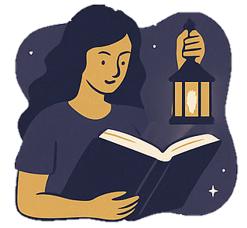
PROBLEM STATEMENT
No dedicated space for folklore, legends, mythology & short story enthusiasts.
Existing platforms are too text-heavy and overwhelming.
Cultural stories risk becoming outdated and underexplored.
Lack of engaging UI/UX to attract younger, digital-native audiences.

Slide 5
solution
LoreTrail: A digital storytelling platform focused on folklore, mythology & fantasy.
Visually engaging UI with interactive storytelling elements.
Makes traditional tales accessible, attractive, and immersive for all ages
Community-driven space for writers & readers to share and explore stories.

Slide 6
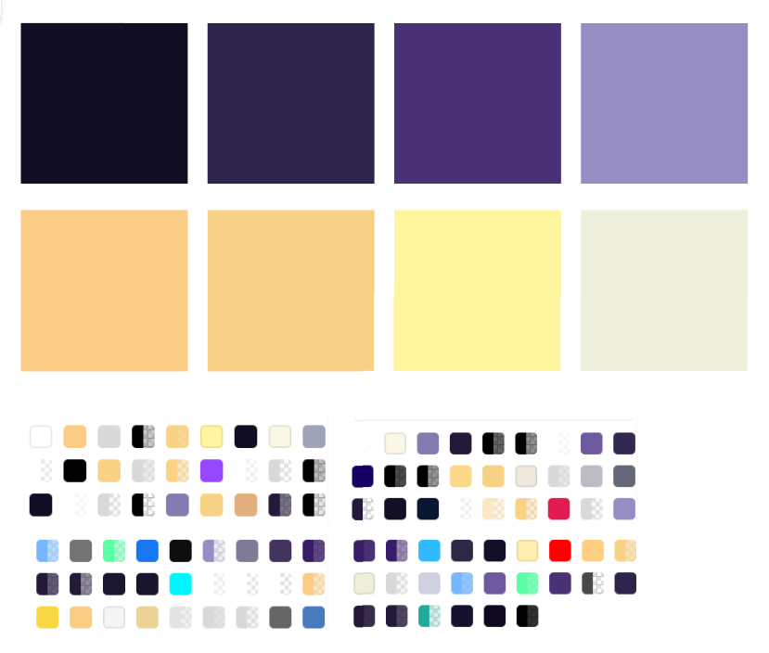
COLOR PALETTE
Shades of Purple form the primary base, symbolizing mystery, creativity, and the enchanting world of folklore and fantasy.
Gold Accents highlight key elements, adding richness and a magical, premium touch.
White and Gold Texts ensure readability while maintaining elegance and contrast.
Together, the palette creates a storybook-like atmosphere that feels immersive, engaging, and visually distinct from text-heavy platforms.

Slide 7
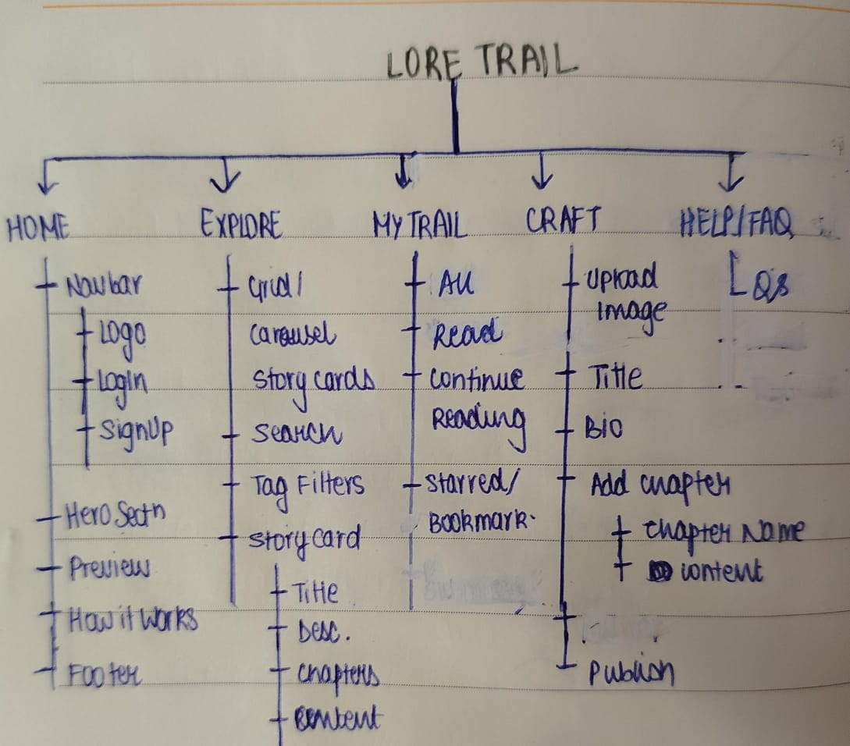
PAGE STRUCTURES
Home Page: Clear CTAs (Craft Story, Explore Stories), featured section, and “How it Works/About Us” for onboarding.
Explore Page: Initially Pinterest-style staggered cards → shifted to clean, symmetric card layout based on user feedback.
My Trail: Personalized library (Continue Reading, Liked, All Reads) with symmetric cards for consistency.
Craft Your Story: Minimal writing interface with Save Draft + Publish buttons to empower creators.
FAQ Page: Guidance for first-time users, reducing confusion.

Slide 8
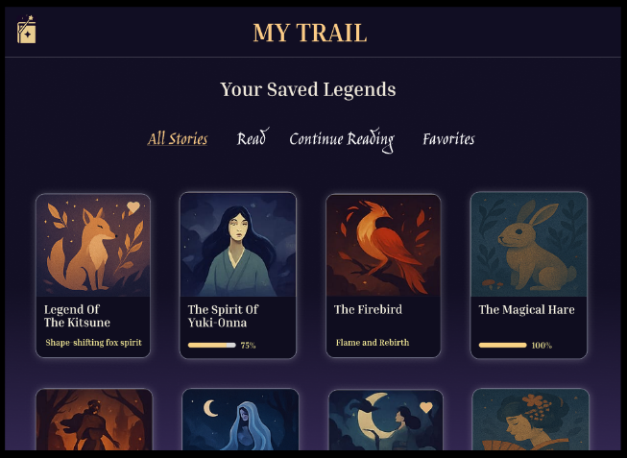
Visual engagement & impact
Shift from text-heavy structures → visual-first storytelling cards for better discoverability.
Pinterest-inspired layouts: more engaging, scroll-friendly, and intuitive.
Symmetric card redesign based on user feedback → cleaner, more organized browsing.
Rich visuals + minimal text help reduce fatigue and keep users immersed in stories.
Result: Higher engagement, easier exploration, and stronger emotional connection.

Slide 9

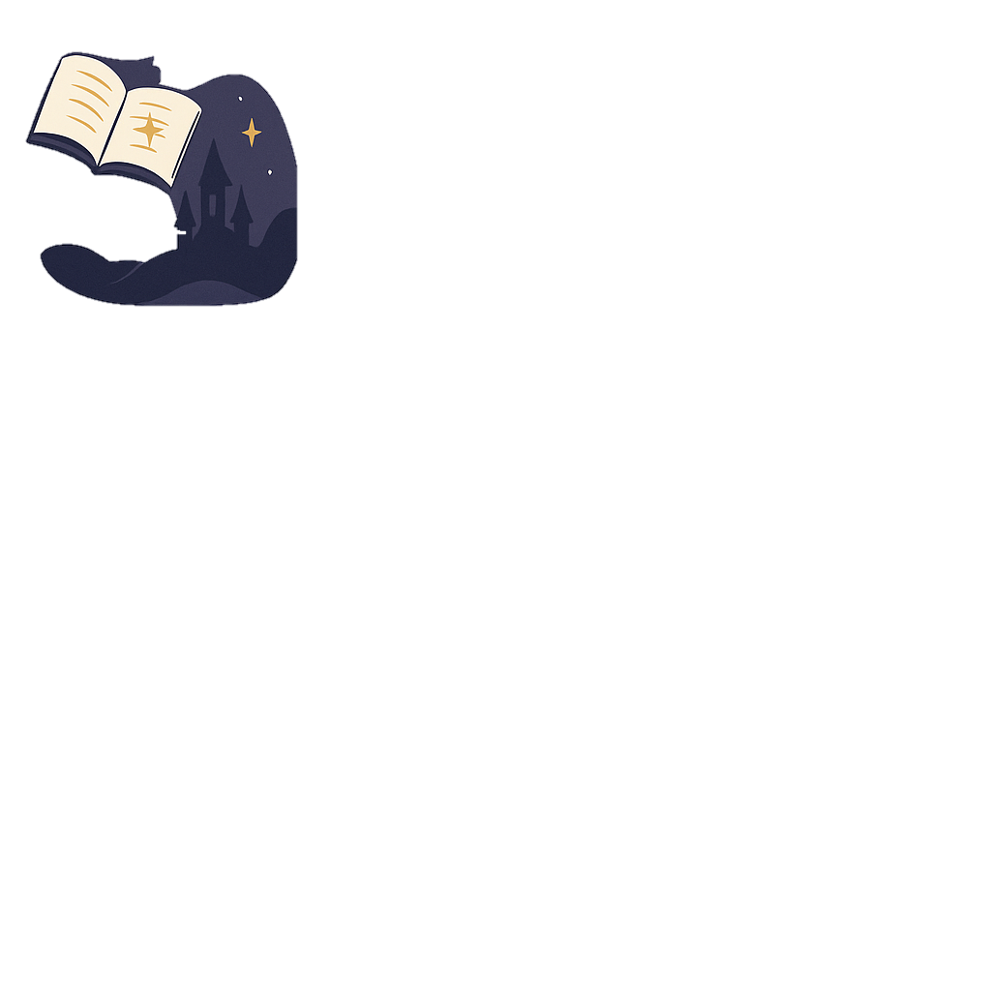
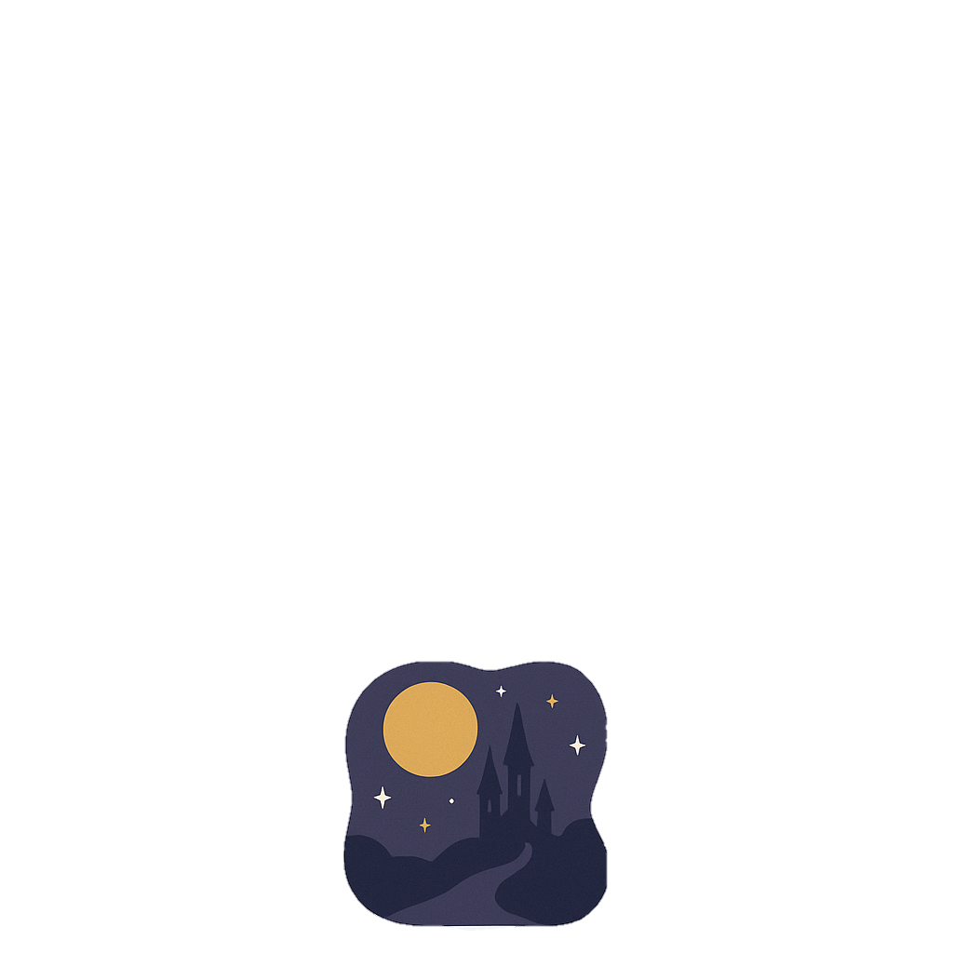
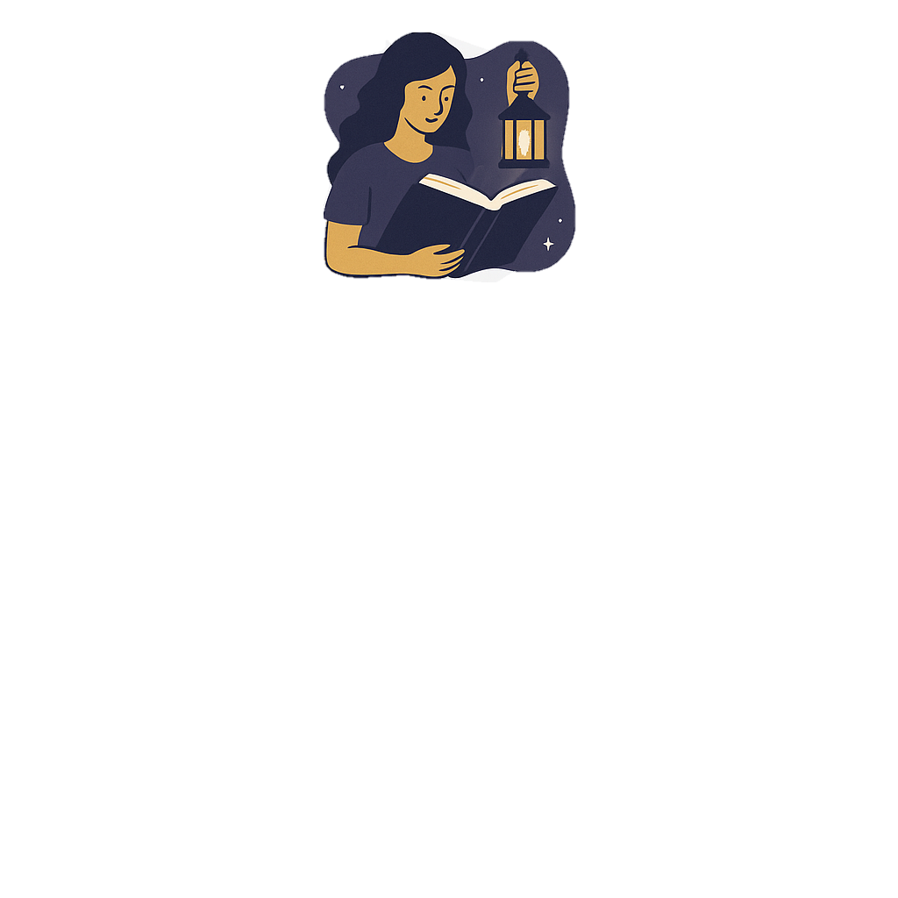
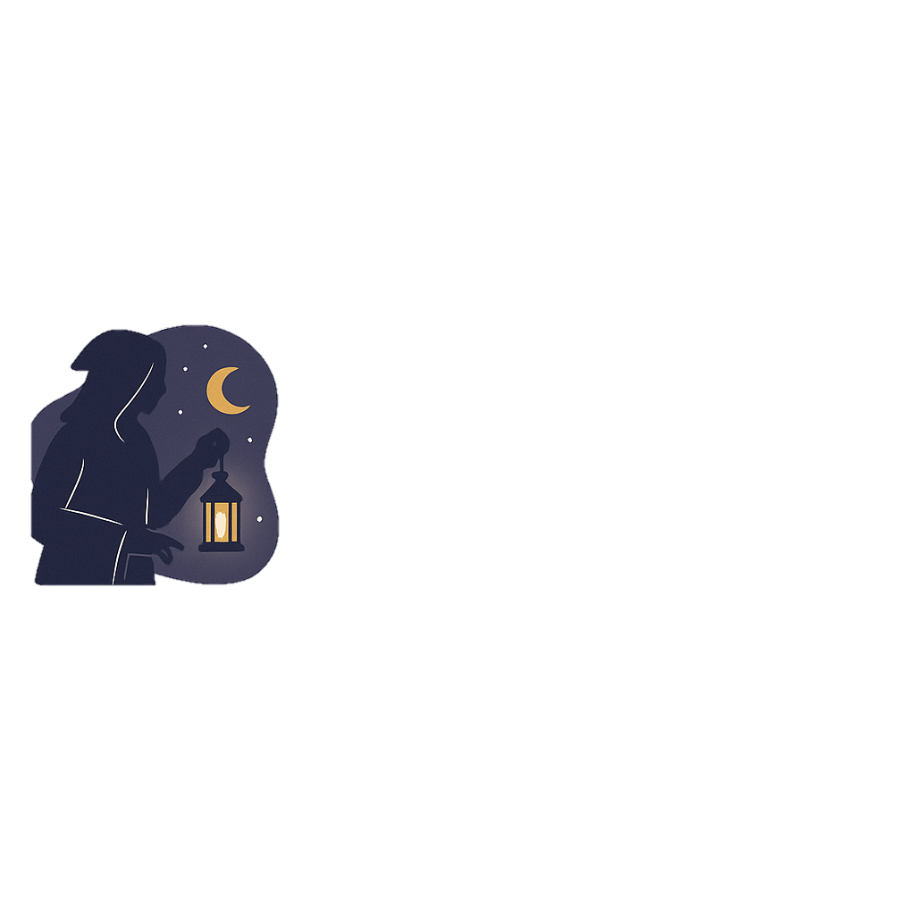
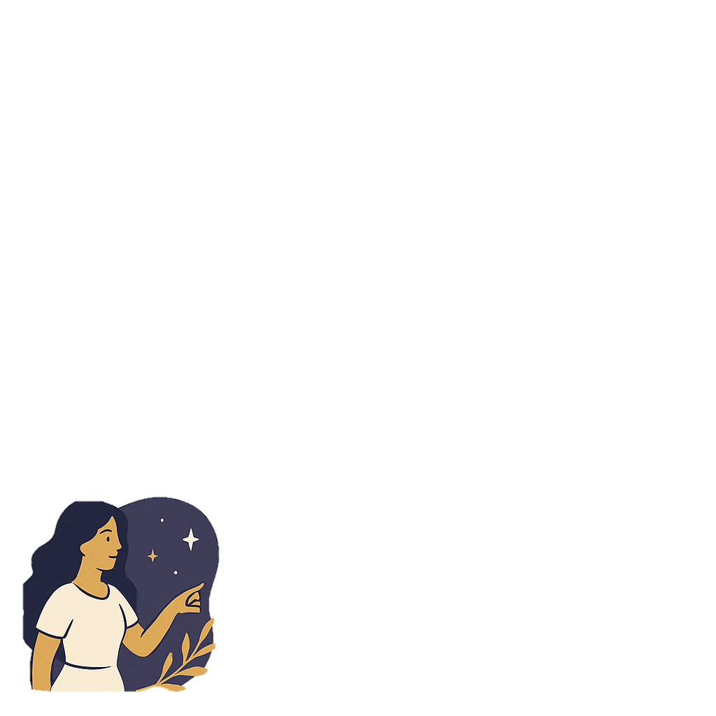

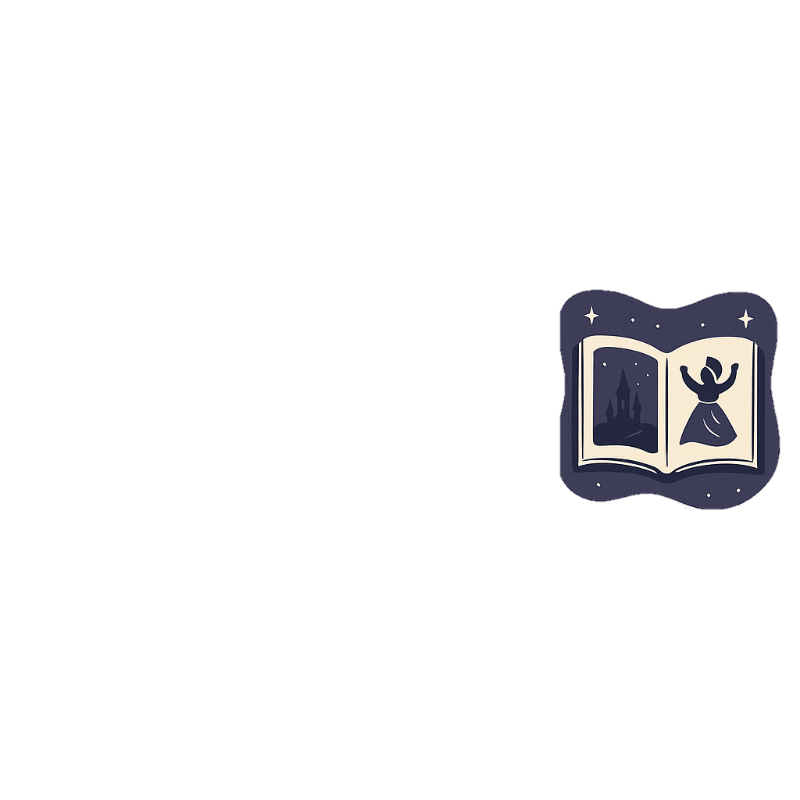

Lore Trail
A digital library of global folklore, myths, and traditions.

Slide 10
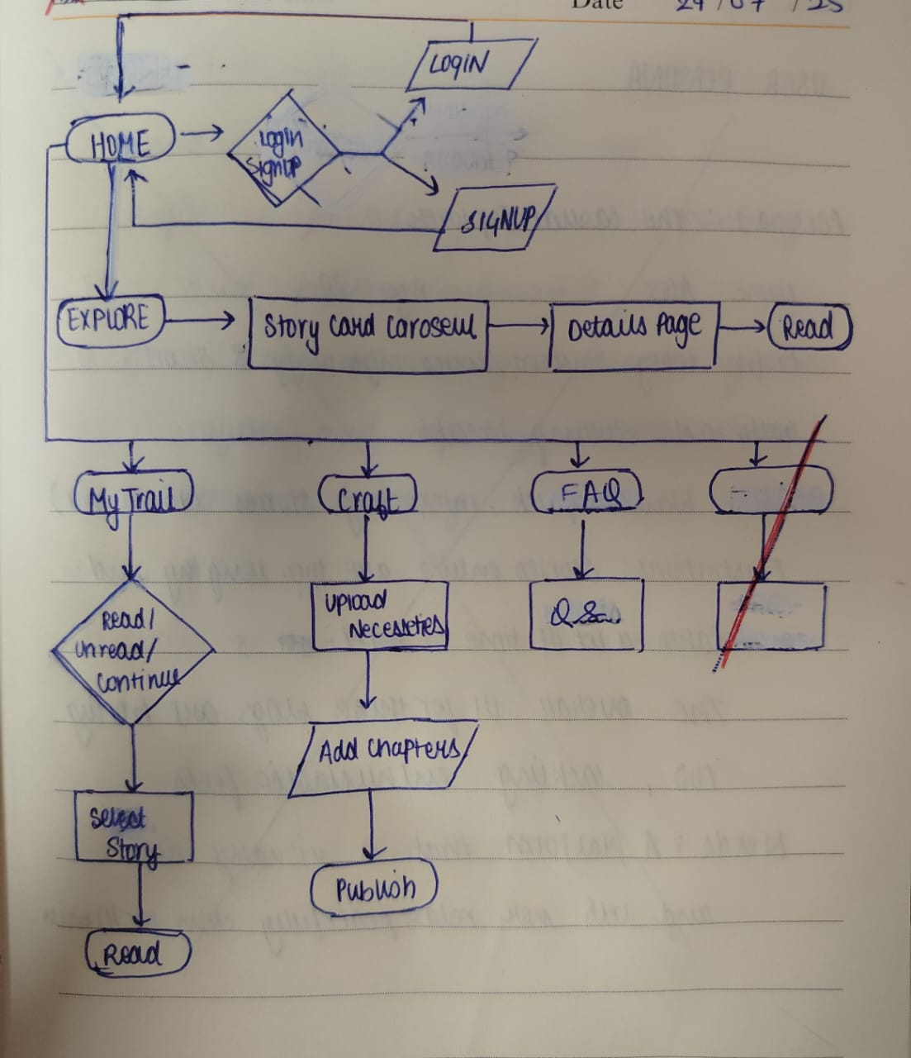

Slide 11
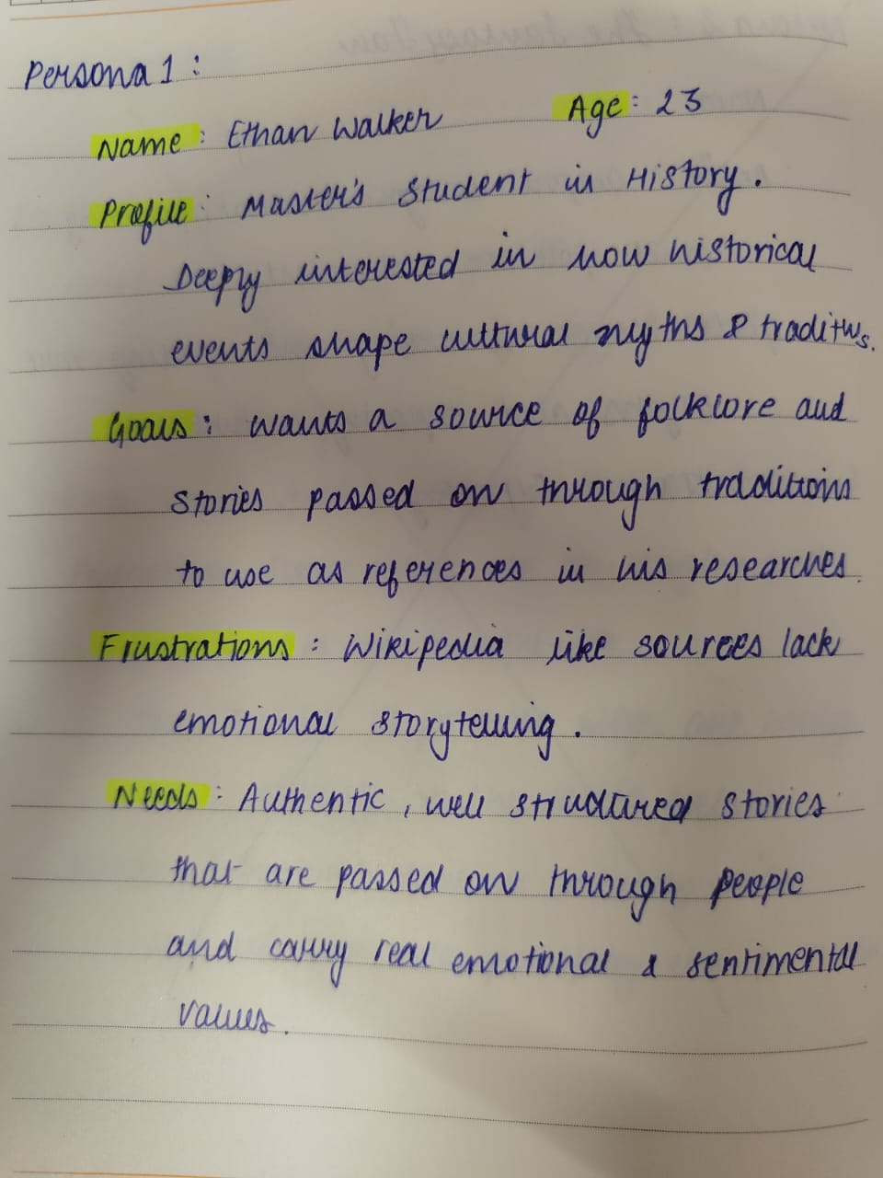
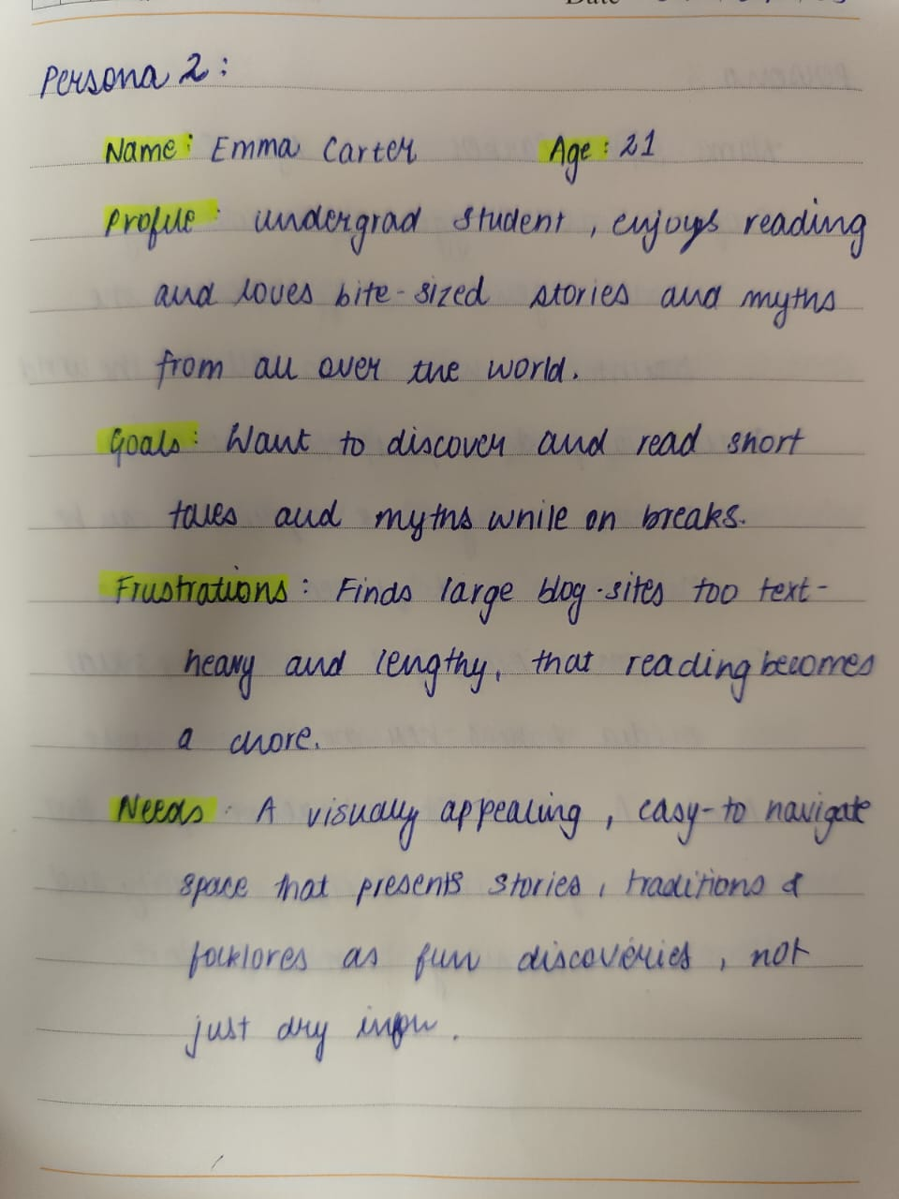
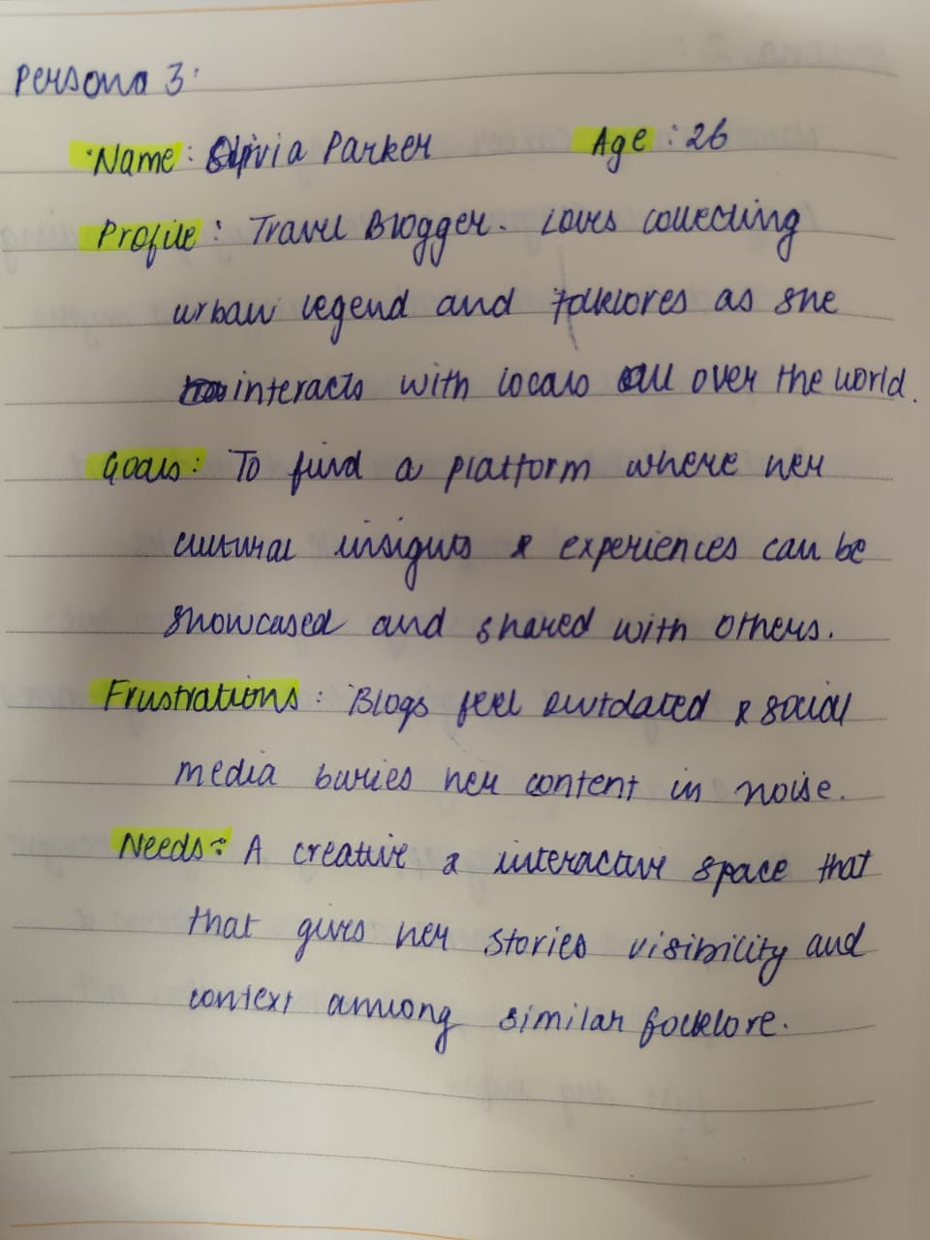
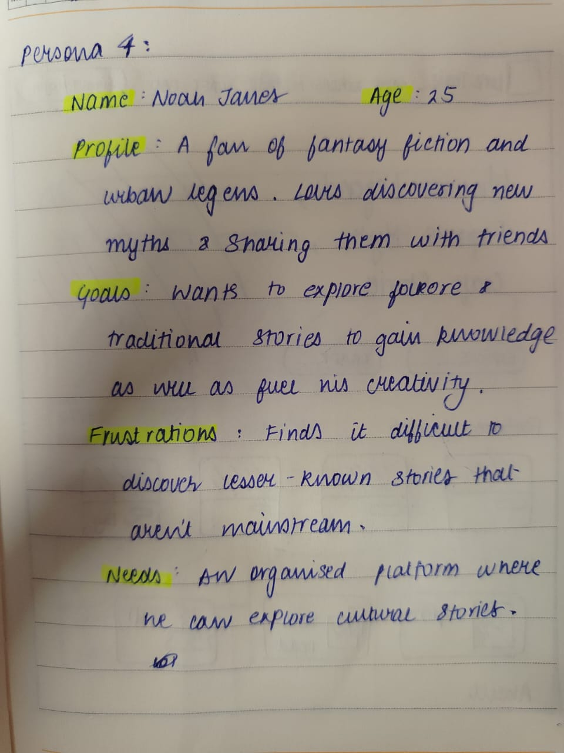

Slide 13
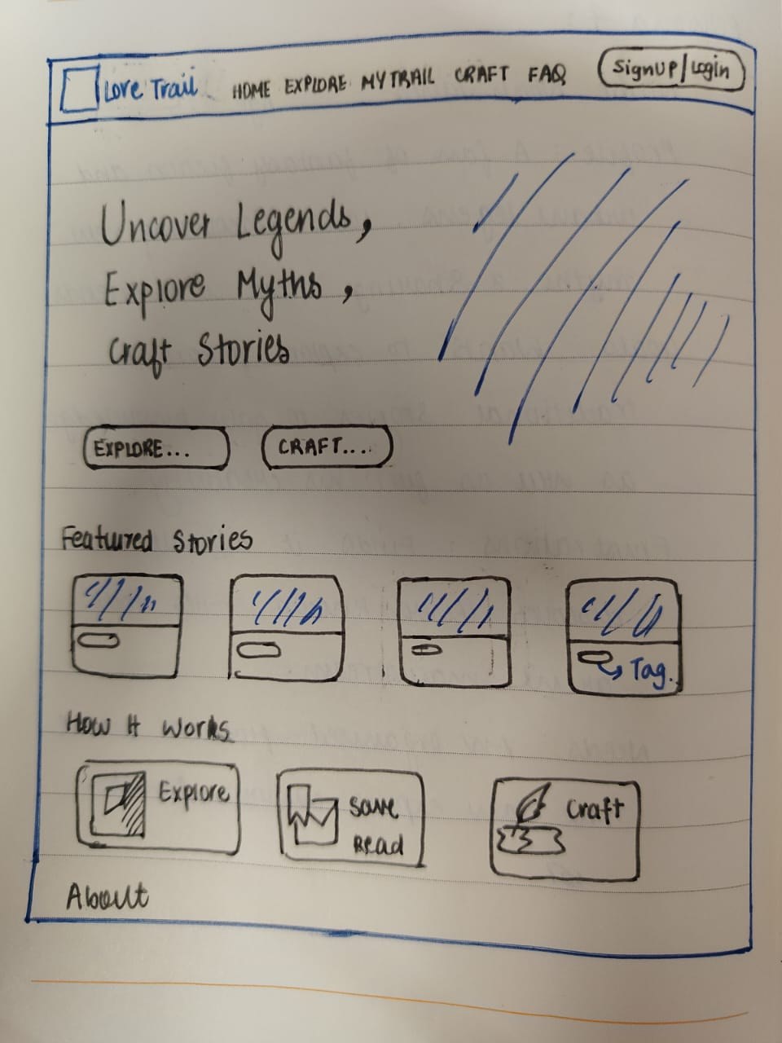
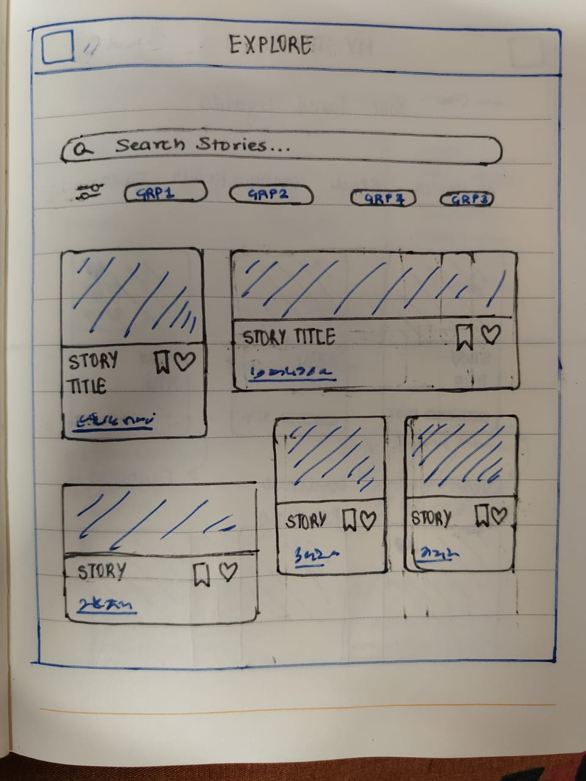
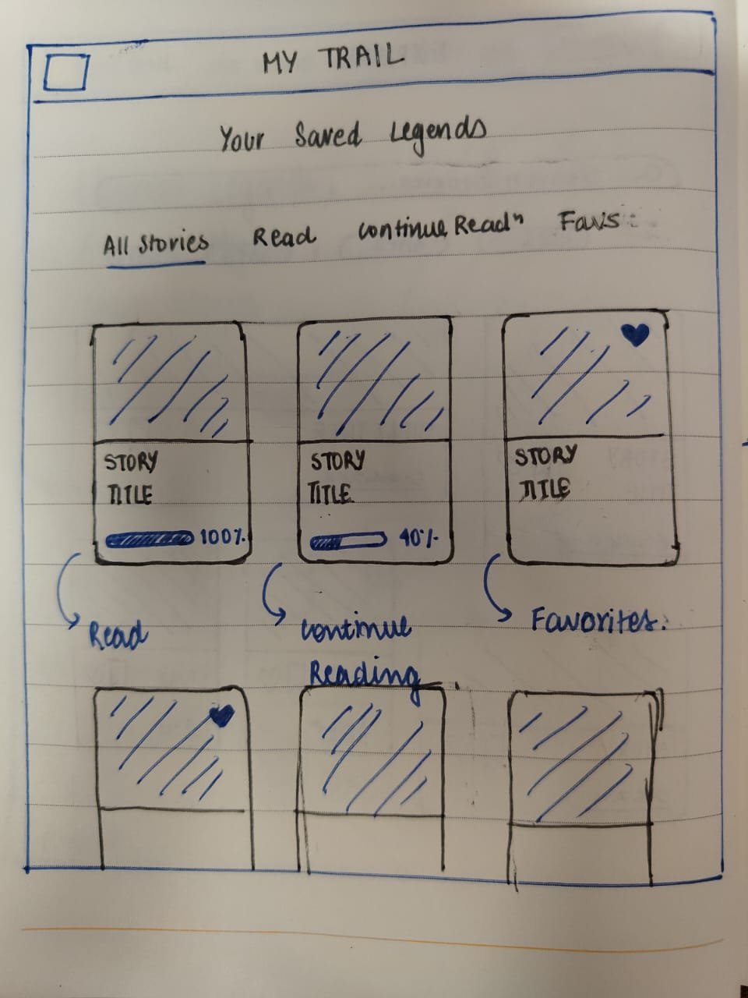
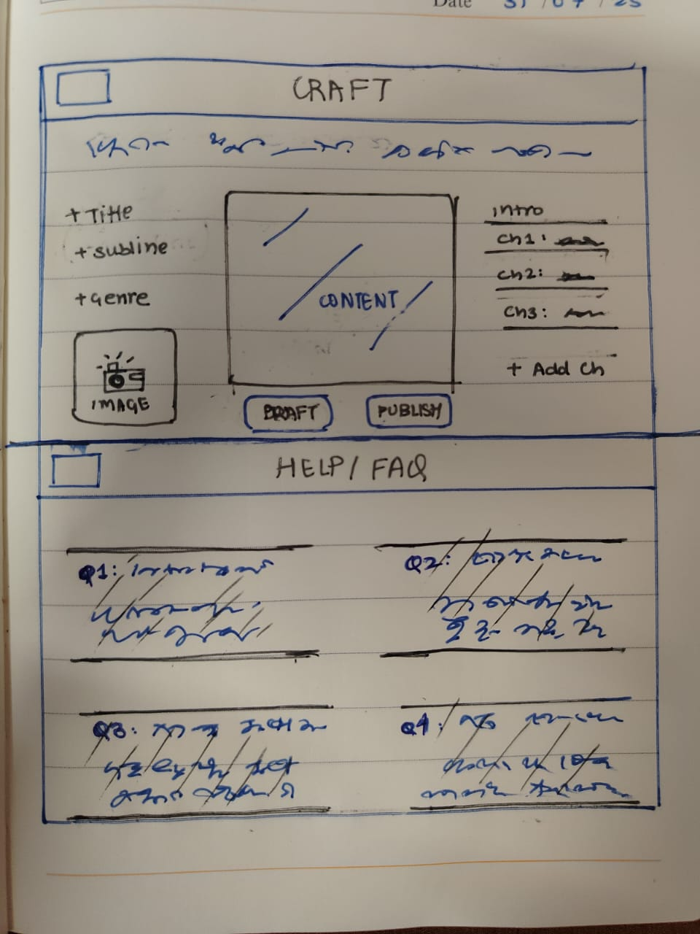
WIREFRAME & PROTOTYPING

Slide 14
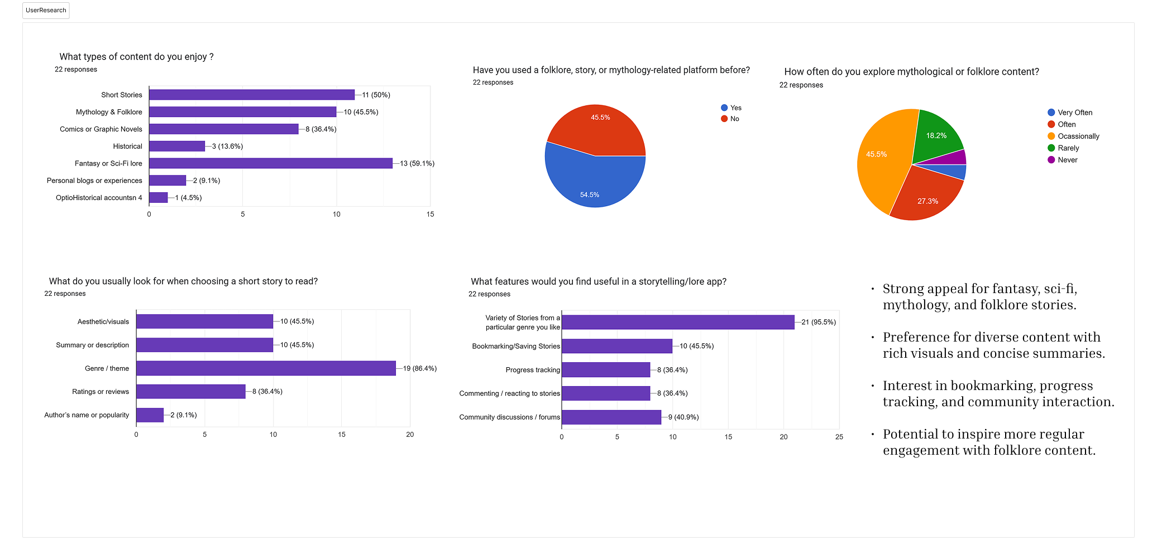

Slide 15
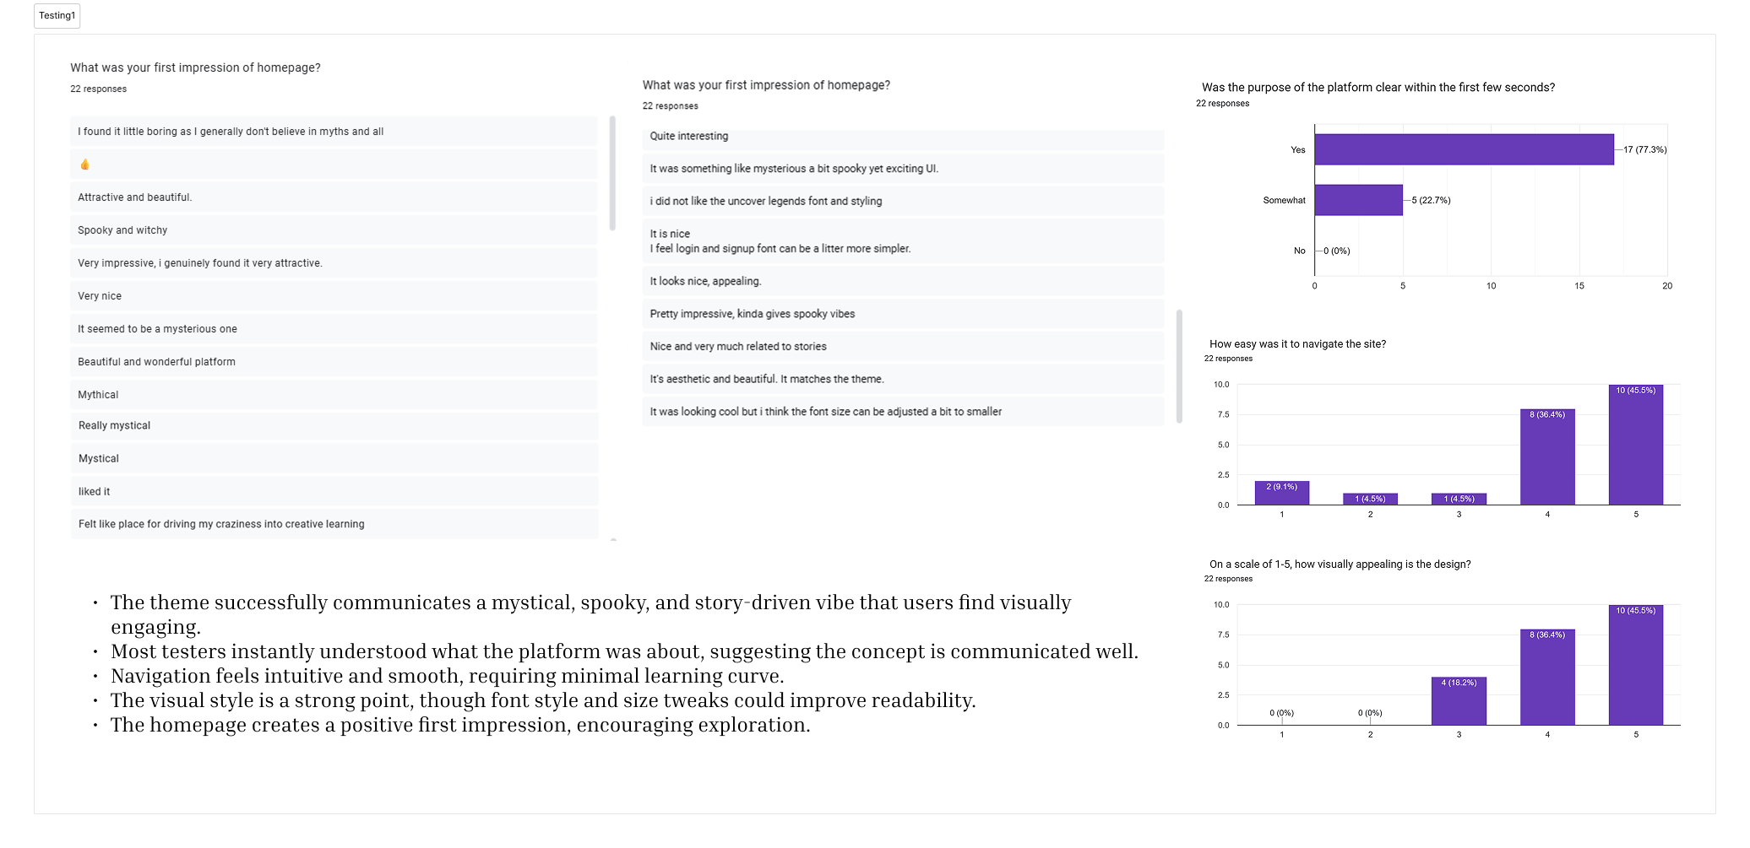

Slide 16
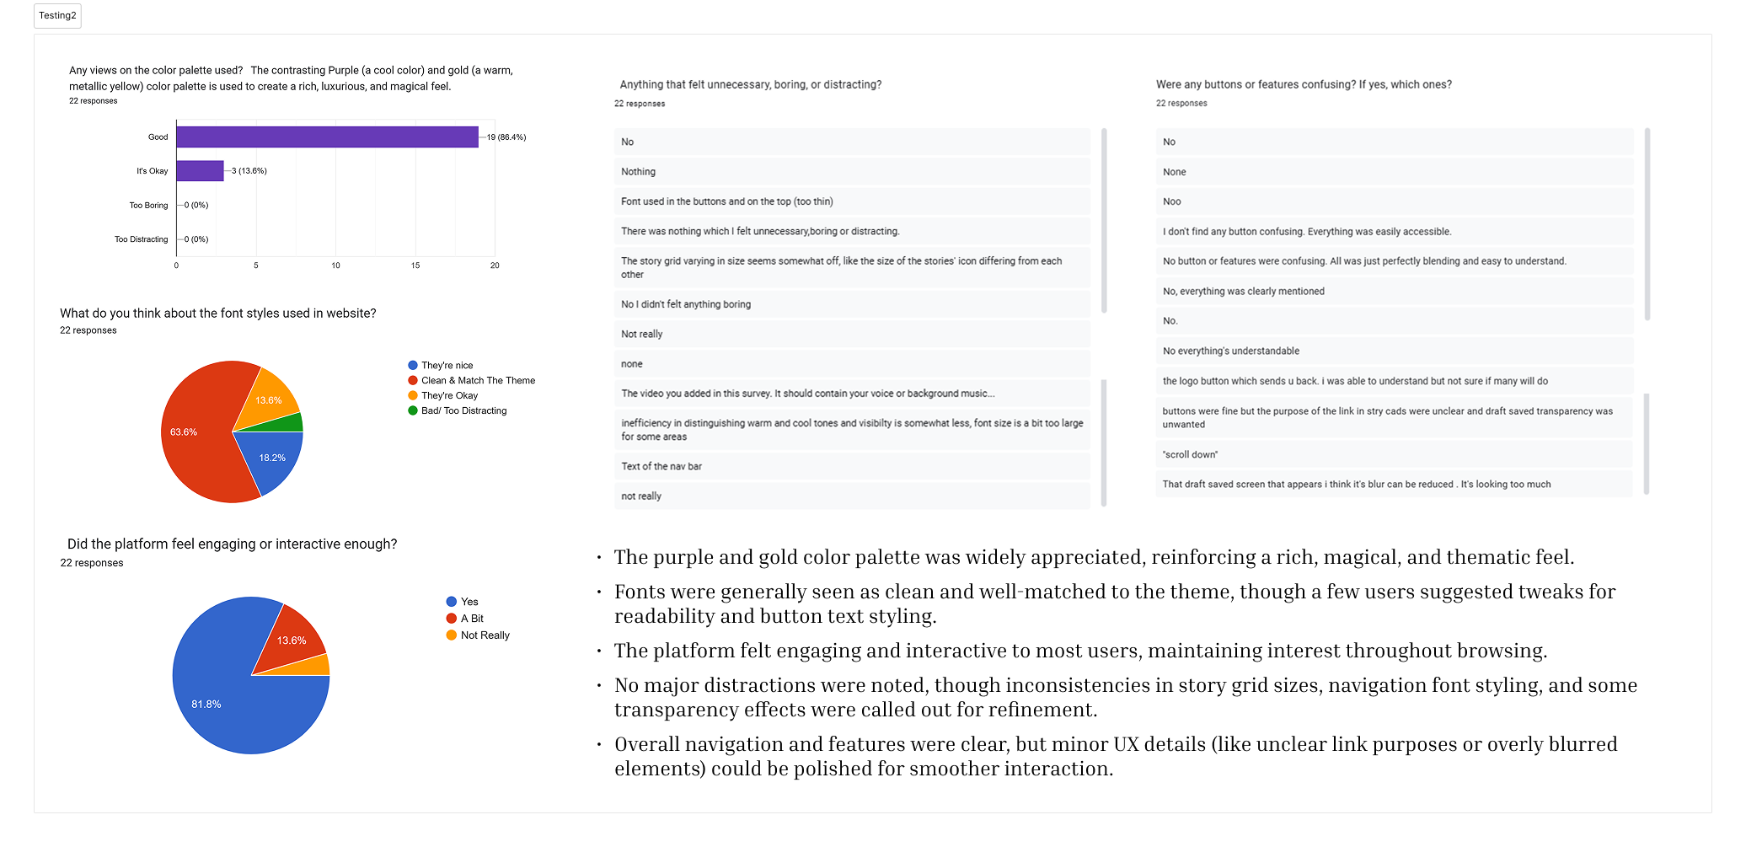

Slide 17
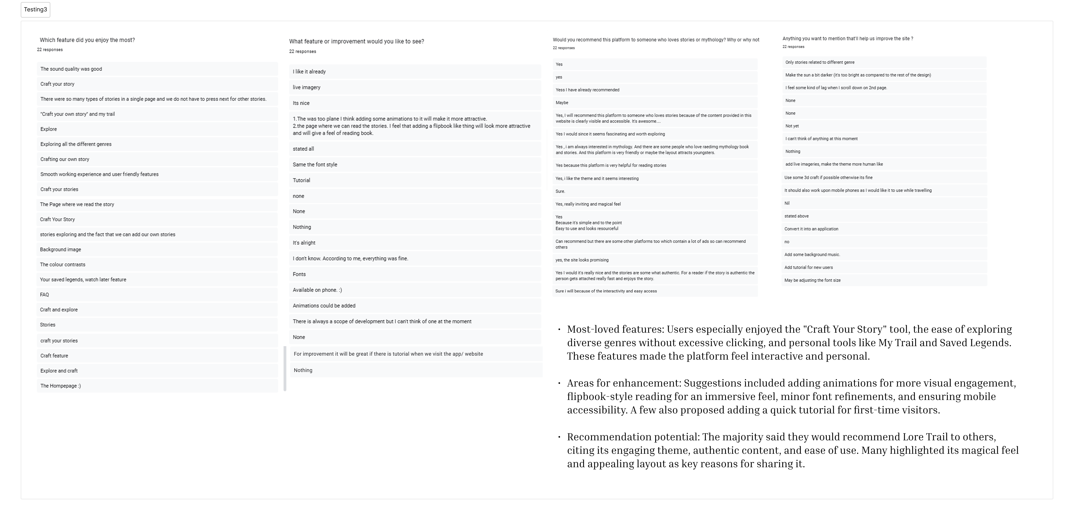

Slide 18
